Slide 1

Pipeline Safety in Michigan
City of Boyne City
Commission Meeting
April 25, 2016
Jennifer McKay
Policy Director
Tip of the Mitt Watershed Council

Slide 2
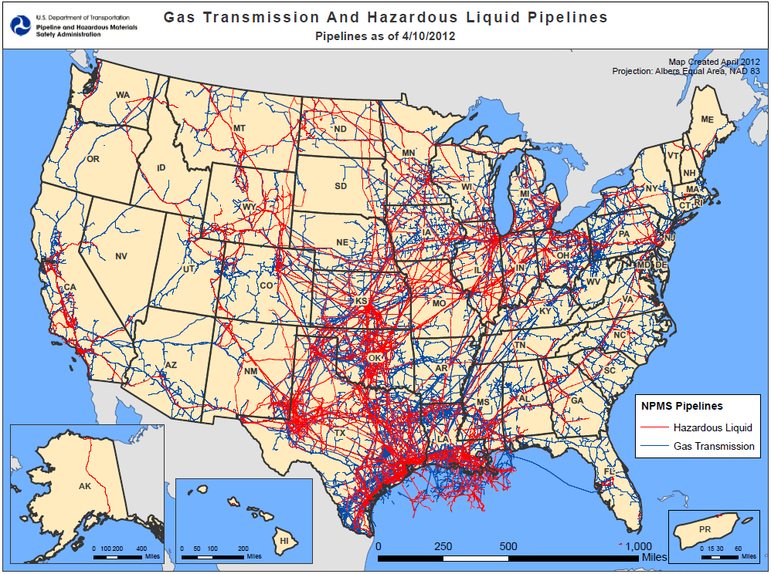

Slide 3
Miles of Pipeline in the US
2.7 million miles of fuel pipelines in the U.S.
93% Natural Gas
7% Hazardous Liquid
Hazardous Liquids:
Crude Oil
Refined petroleum products
Highly volatile liquids/natural gas liquids
Carbon Dioxide
Anhydrous Ammonia
Data Source: US DOT Pipeline and Hazardous Materials Safety Administration Portal Data as of 4/24/2016

Slide 4
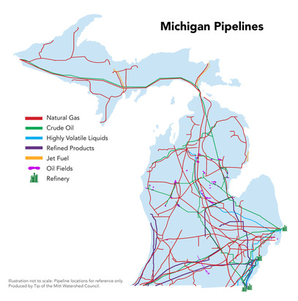
Miles of Pipeline in Michigan
Approximately 125,000 total miles of fuel pipelines in Michigan
121,176 Natural Gas
3,463 miles Hazardous Liquid
1,553 miles crude oil
(Data Source: US DOT PHMSA Portal Data as of 4/24/2016)

Slide 5
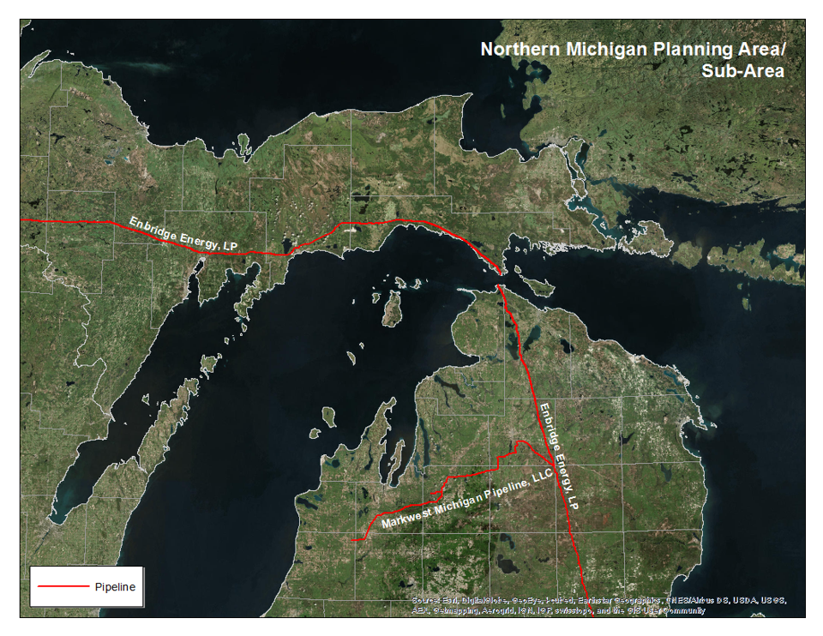

Slide 6
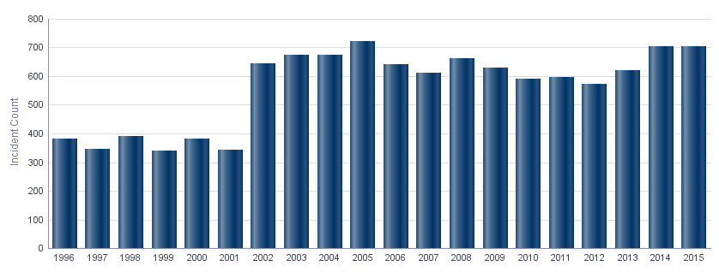
Pipeline Incidents (1996-2015)
Source: PHMSA

Slide 7
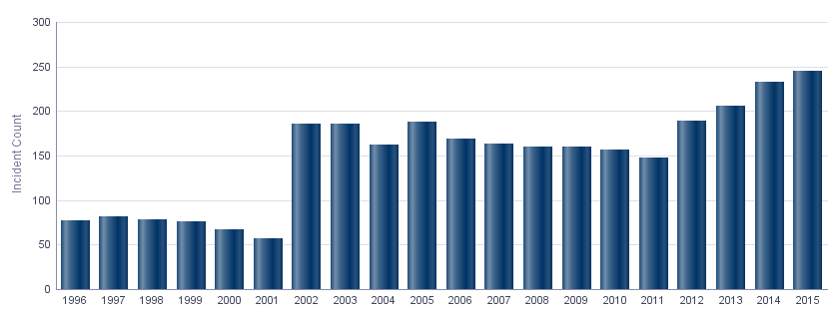
Crude Oil Pipeline Incidents (1996-2015)
2015
224 incidents
811,062 gallons spilled
Source: PHMSA

Slide 8
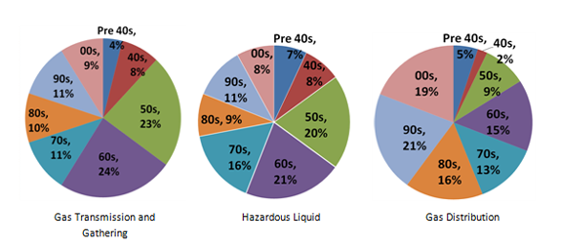
Aging Pipelines in the US
Source: PHMSA

Slide 9
Incident Rates Per Decade
for Hazardous Liquid Pipelines
Source: Pipeline Safety Trust

Slide 10
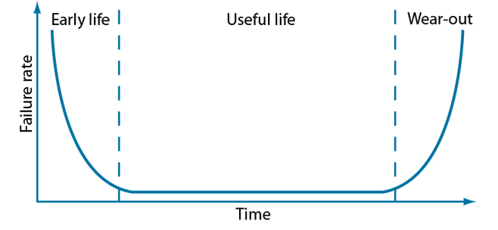
The Bathtub Curve
Reliability specialists often describe the lifetime of a population of products using a graphical representation called the bathtub curve.

Slide 11
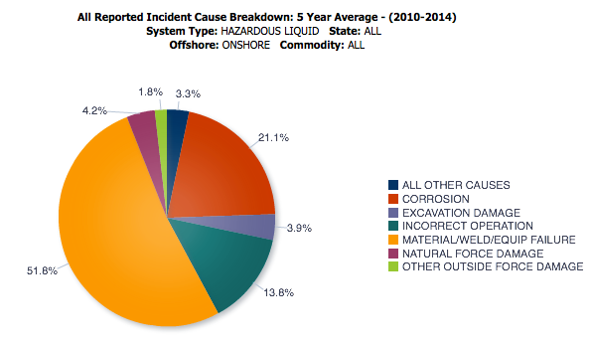
Cause of Hazardous Liquid Incidents
86.7% of failures related to operation and maintenance

Slide 12
Michigan Petroleum Task Force
Convened June 2014
Participants: Attorney General, DEQ, DNR, Public Service Commission, Office of the Great Lakes, Department of Transportation, and State Police, Emergency Management and Homeland Security Division
13 recommendations
4 specific to Line 5 in the Straits of Mackinac
9 apply statewide

Slide 13
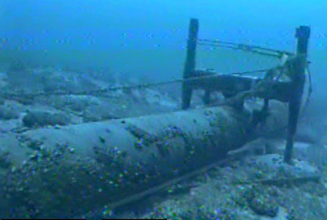

Recommendations Line 5 in the Straits
Prevent the transportation of heavy crude oil
through the Straits Pipelines .
Require an independent risk analysis and adequate
financial assurance for the Straits Pipelines.
Require an independent analysis of alternatives to
the existing Straits Pipelines.
Obtain additional information from Enbridge
relating to the Straits Pipelines.
Image: Enbridge Energy

Slide 14
Statewide Recommendations
Consider issuing an Executive Order creating an Advisory Committee on Pipeline Safety.
Consider legislation requiring state review and approval of oil spill response plans, improved spill reporting, and more robust civil fines.
Coordinate mapping of existing pipelines among state agencies.
Ensure that state agencies collaborate on emergency planning and spill response.
Ensure coordinated emergency response training exercises and drills.
Ensure regular state consultation with the federal Pipeline and Hazardous Materials Safety Administration (PHMSA) on hazardous liquid (including petroleum) pipelines.
Evaluate whether to establish a Hazardous Liquids Pipeline Safety Program in Michigan.
Consider legislation or rulemaking to improve siting process for new petroleum pipelines.
Create a continuing Petroleum Pipeline Information website.

Slide 15
Task Force Recommendations
Prevent the transportation of heavy crude oil
through the Straits Pipelines
Agreement signed between the State and Enbridge
on September 30, 2015.
Loophole
Enbridge could transport heavy oil through the pipelines in the Straits if:
the state approves changes to the engineering or operation of the pipelines that allows for transportation of heavy crude oil or
2) if Enbridge is ordered to transport heavy crude by a regulating agency.

Slide 16
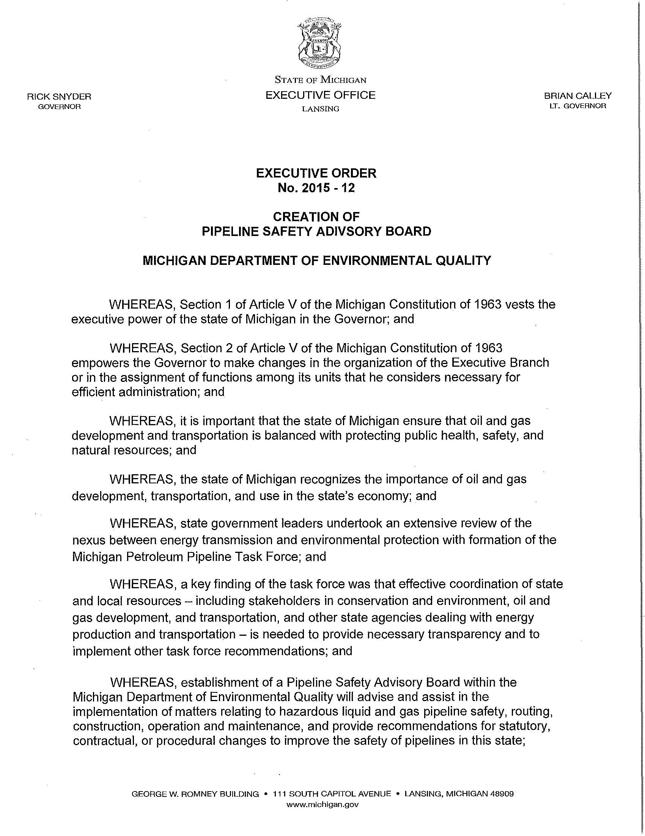
Task Force Recommendations
Consider issuing an Executive Order creating an Advisory Committee on Pipeline Safety
September 3, 2015
Governor issued an Executive Order (2015-12 and 2015-14) creating the Michigan Pipeline Safety Advisory Board

Slide 17
Task Force Recommendations
Require an independent risk analysis and adequate financial assurance for the Straits Pipelines
Expected Completion Date: June 2017
The Easement requires coverage for ALL damages or losses arising from Enbridge’s operations.
Risk analysis will identify consequences of a “worst-case” spill to establish the potential liability.
Enbridge will then be required to maintain financial assurance to cover the identified liability.

Slide 18
Risk Analysis
“Worst-case” spill
“Largest foreseeable discharge of oil…in adverse weather conditions”
Fate and transport of oil released
Timing and cost of containment and cleanup
Short and long term public health and safety impacts
Short and long term ecological impacts and measures to restore/mitigate affected natural resources
• Water quality • Air quality • Fish and aquatic life • Wildlife • Habitat
Economic damages
• Natural resources • Government costs • Navigation • Hunting and fishing • Tourism • Property values • Tax revenues

Slide 19
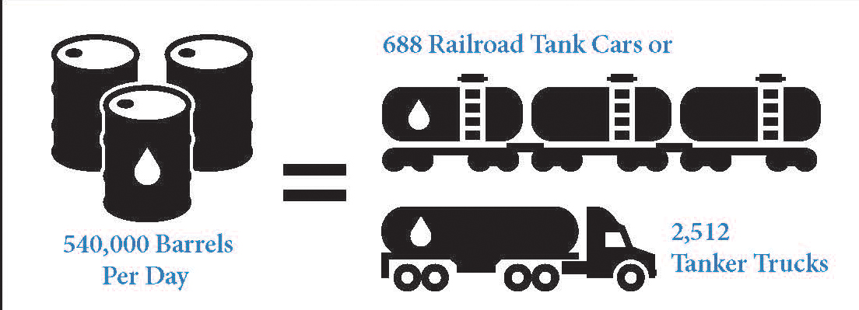
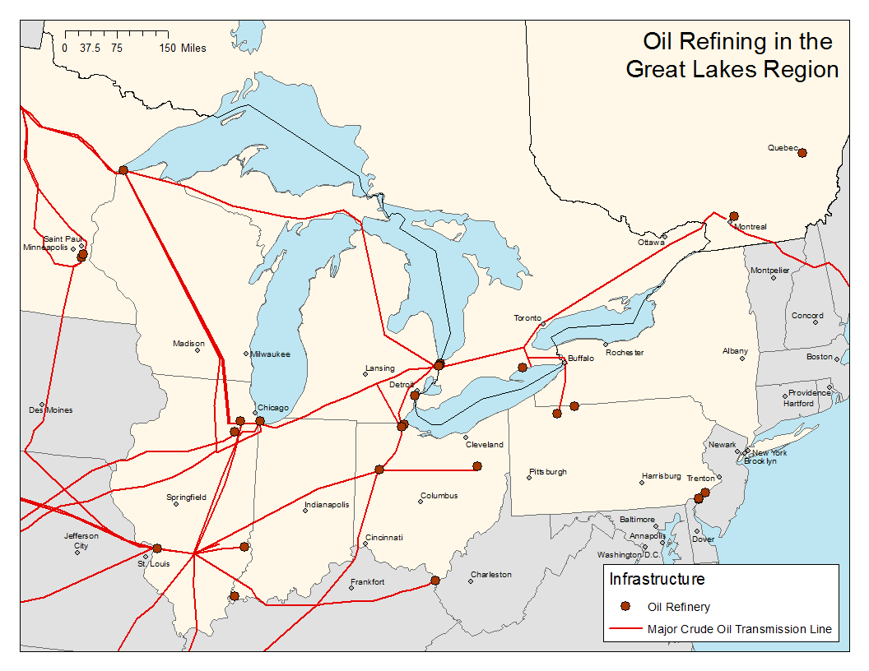
Alternatives Analysis
Alternatives to be Analyzed
Construction of new pipelines
Utilize existing infrastructure
Utilize alternative transportation methods
Vessels, tanker trucks, rail
Replacement
Maintain existing pipeline
Eliminate transport of crude oil and natural gas liquids through Line 5
Michigan Petroleum Pipeline Taskforce Report
Enbridge Energy
Great Lakes Commission
Great Lakes Commission

Slide 20

Thank You
Tip of the Mitt Watershed Council
426 Bay Street. Petoskey. Michigan. 49770
231.347.1181
jenniferm@watershedcouncil.org
www.watershedcouncil.org

