Slide 1
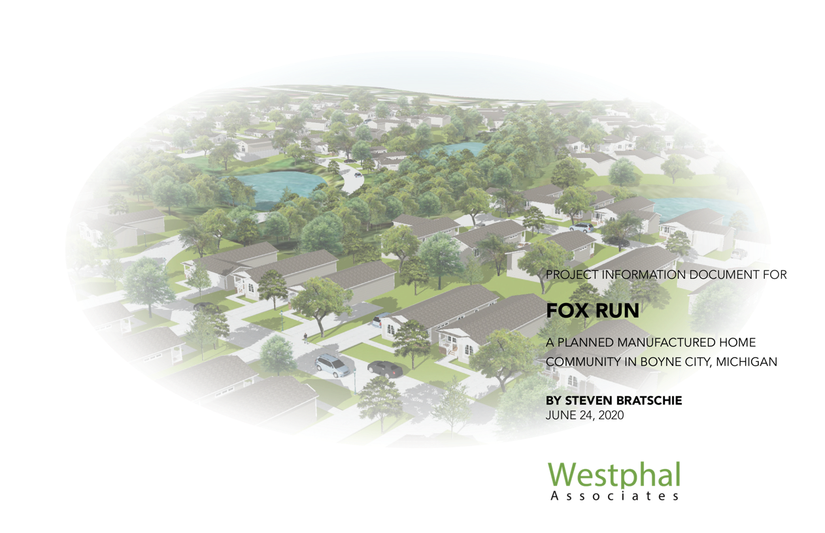

Slide 4
FAQ
What is a manufactured home?
A manufactured home (formerly known as a mobile home) is built to the Manufactured Home Construction and Safety Standards (HUD Code) and displays a red certification label on the exterior of each transportable section. Manufactured homes are built in the controlled environment of a manufacturing plant and are transported in one or more sections on a permanent chassis.
What is the difference between manufactured and modular homes?
Manufactured homes are constructed according to a code administered by the U.S. Department of Housing and Urban Development (HUD Code). The HUD Code, unlike conventional building codes, requires manufactured homes to be constructed on a permanent chassis. Modular homes are constructed to the same state, local or regional building codes as site-built homes. Other types of systems-built homes include panelized wall systems, log homes, structural insulated panels, and insulating concrete forms.

Slide 5
What are my options for financing the purchase of a manufactured home?
There are many alternatives for financing your home, including a growing number of lending institutions that are providing conventional and government-insured financing plans for prospective owners. The most common method of financing a manufactured home is through a retail installment contract, available through your retailer. Some lending institutions that offer conventional, long-term real estate mortgages may require the homes to be placed on approved foundations. Manufactured homes are eligible for government-insured loans offered by the Federal Housing Administration (FHA), the Veterans Administration (VA), and the Rural Housing Services (RHS) under the U.S. Department of Agriculture.
Are manufactured homes a good investment?
Manufactured homes appreciate in value just like site-built houses. Start building equity instead of pouring rent money down the drain. You will get the investment and tax advantages that only come with owning your own home.

Slide 6
Aren’t site-built homes better than manufactured homes?
No! Manufactured homes are the only housing in America built to a national code. I have previously detailed many of the advantages of manufactured homes versus the site built — including the fact that manufactured homes are constructed in a factory environment that is not subject to weather conditions that can impact a home built on site. Energy efficiency and fire safety are just two of many qualities of manufactured home construction that are superior to a typical site-built home.
Is it ok to use the word trailer?
NO! People in the industry would have a heart-attack if they heard anyone use the term trailer. Trailer is an outdated, derogatory slang term for a mobile home and should not be used. Likewise, the word ‘trailer park’ should not be used. The correct term is ‘mobile home’ or ‘manufactured home’ community or land lease community. ‘Trailer’ should be used for campers that you tow behind your vehicle or vintage mobile homes made before 1954 (when the Trailer Coach Association of America renamed themselves The Mobile Home Association).

Slide 7
Are manufactured homes safe?
Yes! Yes! Yes! Yes! Manufactured homes are built to the HUD Code which is a performance-based construction and safety standard. Homes are built to regional conditions. Research has shown manufactured homes can withstand weather events like hurricanes as well as or better than site-built homes.
Insurance studies reflect the fact that manufactured homes today are designed to prevent fires, and have features designed to inhibit and limit the damage caused should a fire occur. 99% of the things you think you know about a manufactured home is most likely false – they are safer than stick-built homes and have 50% fewer deaths by fire.
Is Fox Run going to be a section 8 or government subsidized housing project?
NO, it is a market rent land lease community that is not subsidized by any government funding.

Slide 8
What will the monthly cost be for buying a new manufactured home?
Fox Run will offer for sale new Champion manufactured homes that will range in price from approximately $55,000 to $125,000. See https://www.championhomes.com/about-champion-homes There are a number of sources for financing the homes purchased by the residents.
Cascade Financial, www.cascadeloans.com, offers loans with credit scores as low as 575, up to 50% debt to income ratios and as little as 5% down for qualified buyers. Amortization available up to 23 years.
For example, a $55,000 home, using 6% interest the payments would be $350/month with 5% down, $334/month with 10% down, $312/month with 15% down, and $294/month with 20% down. Add $450/lot rent and monthly payments are as low as $744/month, plus utilities.
The payment on a $100,000 home (which would be a well-appointed 3 bedroom 2 bath home) using 6% interest, could be as low as $635/month with only 5% down, $602/month with 10% down, $568/month with 15% down, or $535/month with 20% down. With 50% debt to income ratios, income levels could be as low as $23,640.
With financing potentially available from local banks, the cost for debt service on a loan is about $8 per $1000 borrowed. Citizens National Bank Petoskey, 231- 881-9294, offer loans for the new homes with a 15-year amortization, 25% down at 7%. A $100,000 home requires a $640 payment/month + $450 rent then at 35% debt-income ratio would be $37,000 gross income. Or a $55,000 home would require $352/payment plus lot rent of $450 for a total of $802/month or around $28,000 year of gross income to qualify.

Slide 9
How many homes sites will be available in Fox Run?
145 sites have been designed to fit the 30 acres which will be a combination of sites for single unit homes and double unit homes. This equals 4.9 units an acre a decrease from the current density of 7.06 dwelling units per acre under the current zoning . The maximum units permitted by state law is 6 units an acre.
When is Fox Run going to be open for business?
If all approvals are obtained as quickly as possible from all government agencies, Fox Run should be available to sell homes in the summer of 2021.

Slide 10
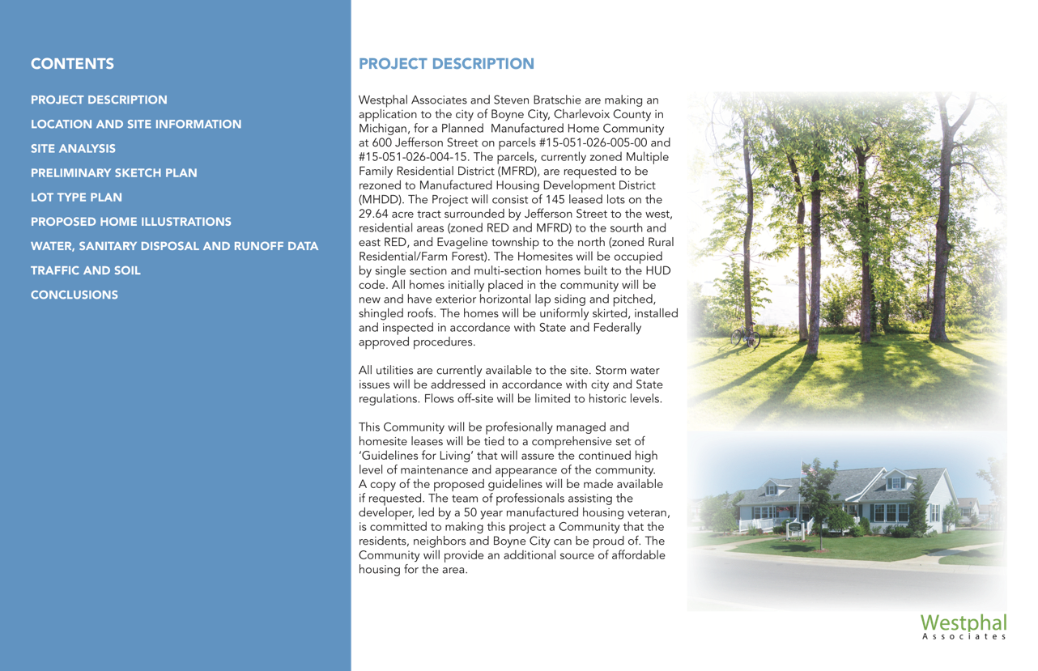

Slide 12
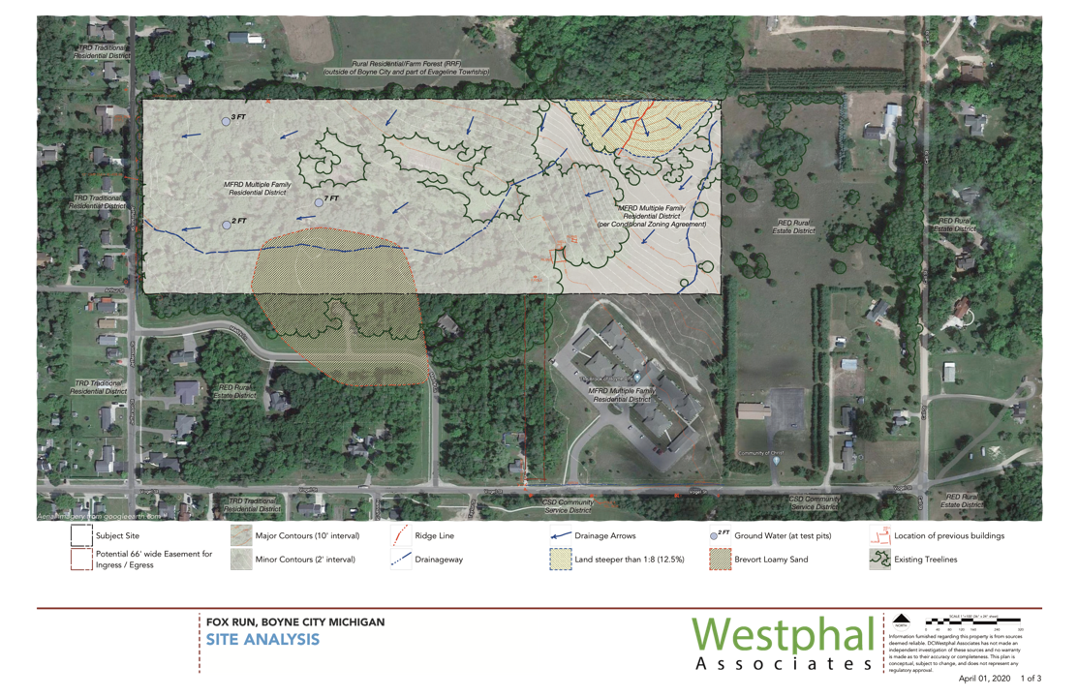

Slide 13
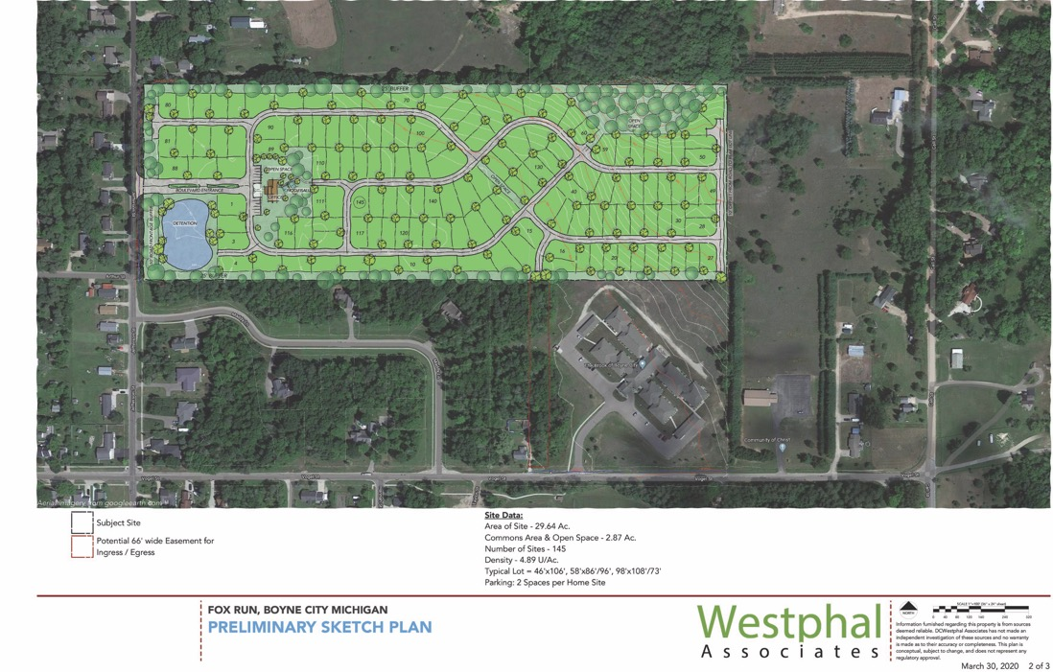

Slide 14
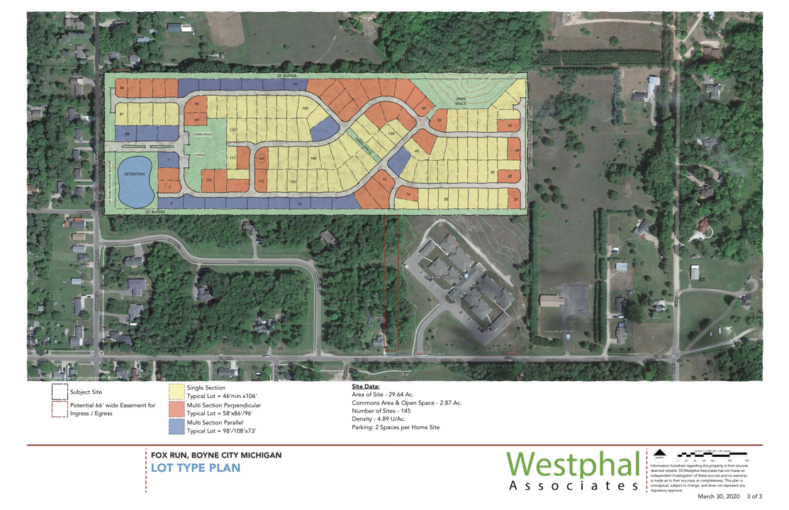

Slide 16
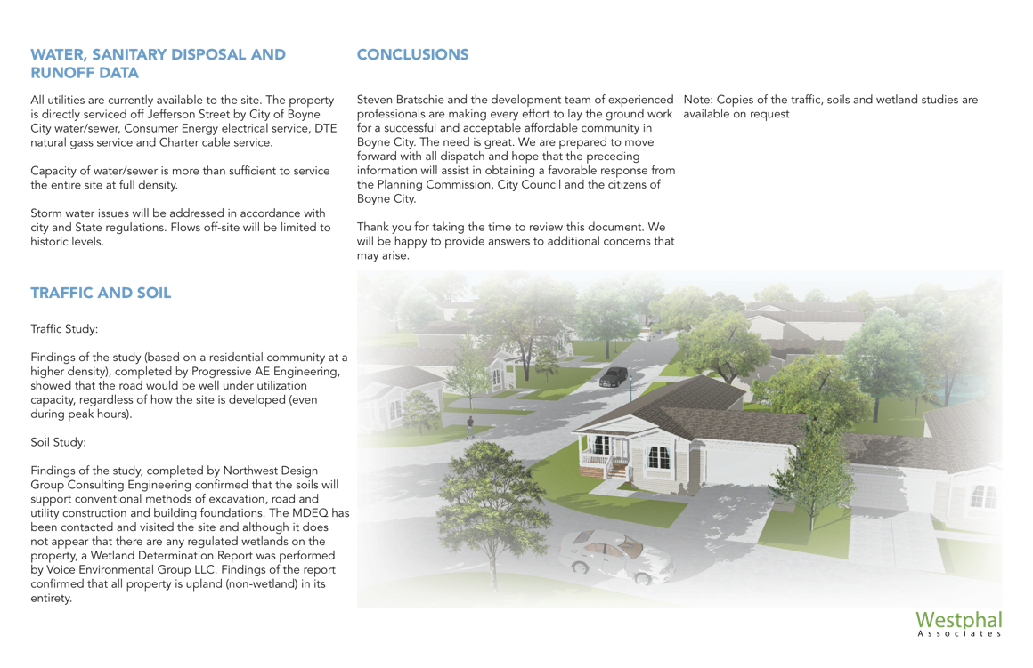

Slide 17
Quotes from the community
Would be extremely interested in the new manufactured home community for my son and I! Great idea!
– Alyssa Belcher
Hey, I’m very interested in this! I currently live in Boyne City, but have been renting for the last six years in the same place and would love the opportunity to own my own home. If you have anymore information, please keep me posted!
– Tori

Slide 18
I am very interested in your manufactured homes going into Boyne city next year! I would love the opportunity for this. For me it’s a chance of a lifetime! My name is Randi bowman, if you would like my number, I’m more than happy to send it to you! And information you need I will provide. Please let me know!
– Anonymous
Hello, Yes me and my husband have lived in Boyne city for 3 years now (also grew up here) and we have almost two-year-old twins! We currently live in an apartment and have been desperately looking for other options. can we schedule a time I could call you tomorrow? I was thinking sometime between 10am-11am. Thank you!
– Bailee M

Slide 19
Thank you for listening!

