Slide 1
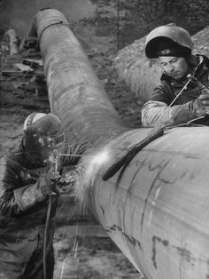
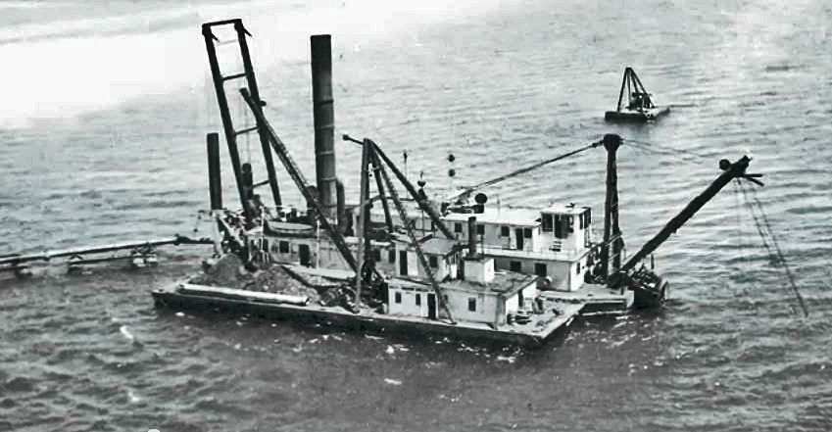
Failure of Vintage Pipelines
A vintage pipeline is one put into service before ca. 1970

Slide 2
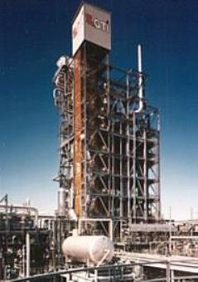
Edward E. Timm, PhD, PE
BS, MS, PhD in Chemical Engineering from University of Michigan
Licensed Professional Engineer, Michigan
Retired as Senior Scientist, The Dow Chemical Company after 27 years
26 US Patents
Expertise in all areas of chemical
engineering with an emphasis on
innovation, design, troubleshooting
and new business analysis
Hands on experience with most
petrochemical and refinery processes
Last years of Dow career devoted to
Environmental Operations and cleanup
technology

Slide 3
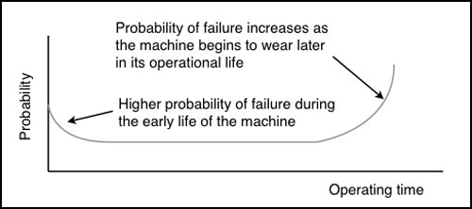
The Universal Law of Mechanical Failure
The Universal Law of Mechanical Failure Applied to Pipelines
Early on, bad welds and other construction defects cause failures
Once proven, pipelines can operate with an acceptable failure probability
As pipelines age, probability of failure is determined by maintenance
Pipelines are scrapped when maintenance costs and risks become excessive

Slide 4
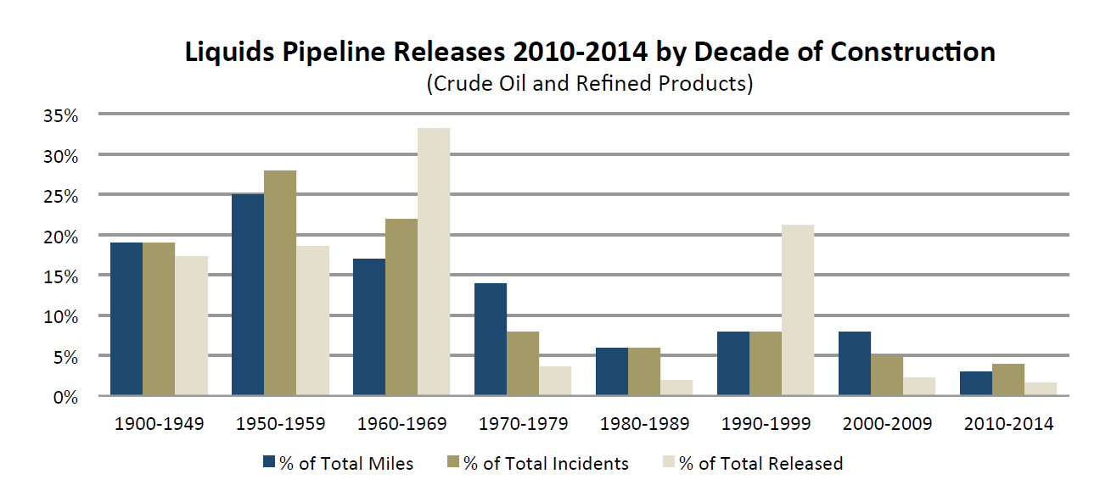
60% of operational oil and refined product pipelines are vintage pipelines
The main cause of leakage from vintage pipelines is external corrosion
The main cause of rupture of vintage pipelines is stress corrosion cracking
Constant inspection and repair is required to keep these lines “Fit for Service”
“Fitness for Service” is determined by the pipeline owner
External Corrosion is the Main Cause of Vintage Pipeline Leakage

Slide 5
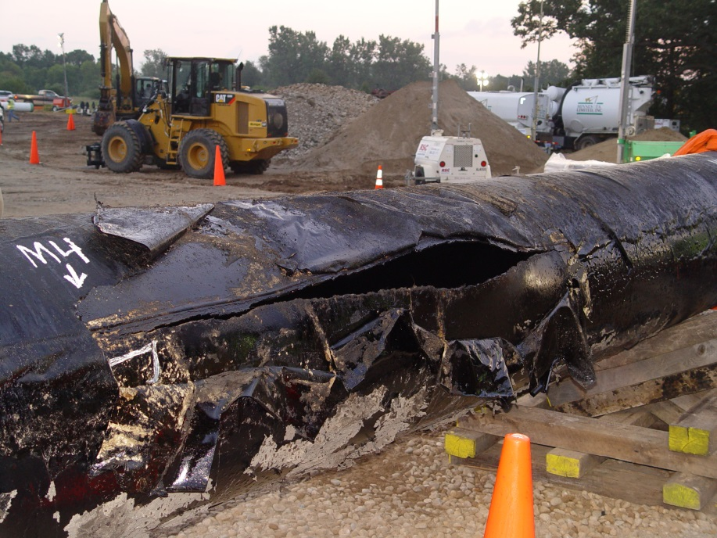
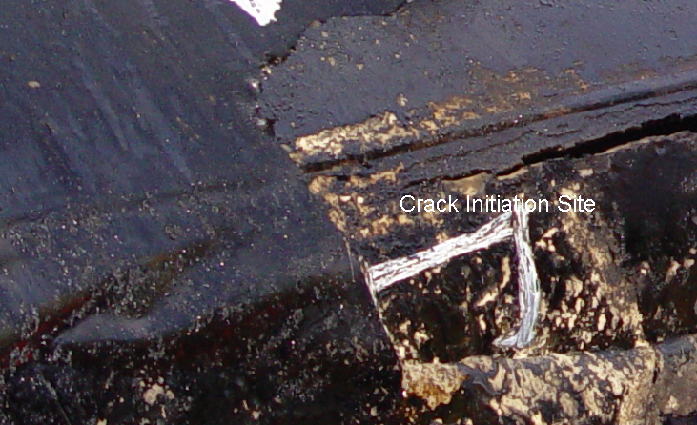
Enbridge Line 6b Rupture – “Fit for Service”
Constructed in 1969
Rupture July 25, 2010
Service Life to Major Rupture: 41 Years
1,100,000 Gallons Spilled
Claimed Response Time: 11 minutes
Actual Response Time: 17 Hours
PHMSA Finding
“A 2005 Enbridge engineering
assessment and the company's
criteria for excavation and repair
showed that six crack-like defects
ranging in length from 9.3 to 51.6 inches
were left in the pipeline, unrepaired,
until the July 2010 rupture.”

Slide 6
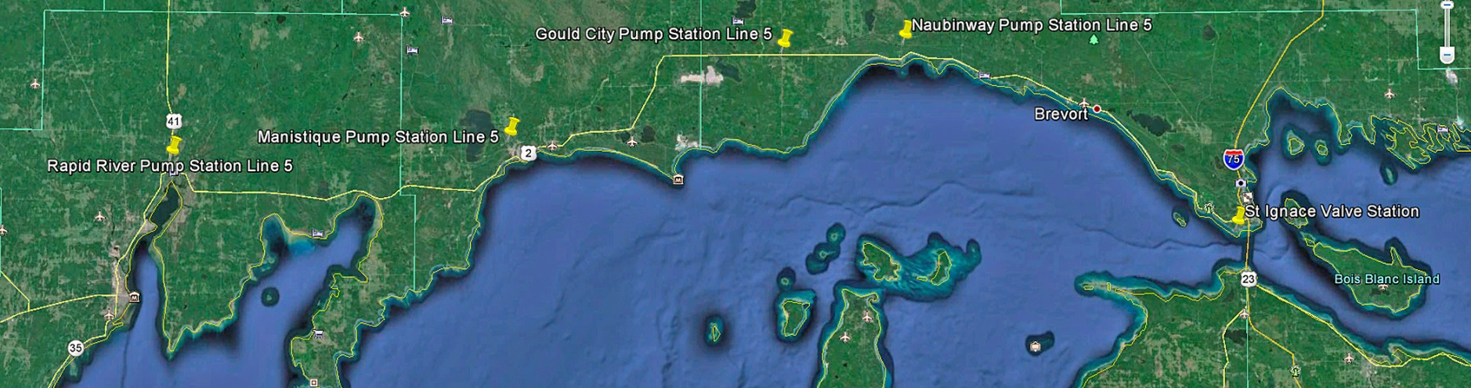
Line 5 Route along the North Shore of Lake Michigan
In some places Line 5 runs within 250 yards of the Lake and it has numerous water crossings
Line 5 is really two very different pipelines
The two Line 5 Straits crossings are totally unique and the first of their kind, an engineering masterpiece with one major design error
The other 641 miles of Line 5 are of typical, run of the mill ’50’s vintage cross country pipeline construction consisting of twelve highly modified sections.
This pipe is corrosion prone, thin wall seamed pipe that is suspect

Slide 7
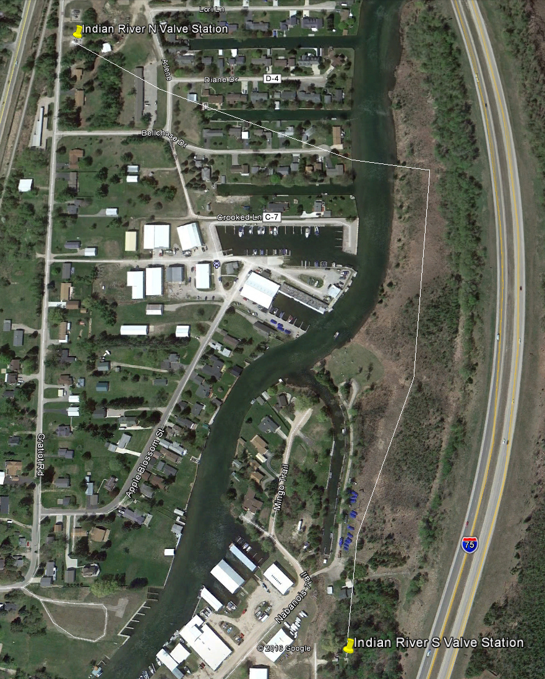
Line 5 Indian River Crossing

Slide 8
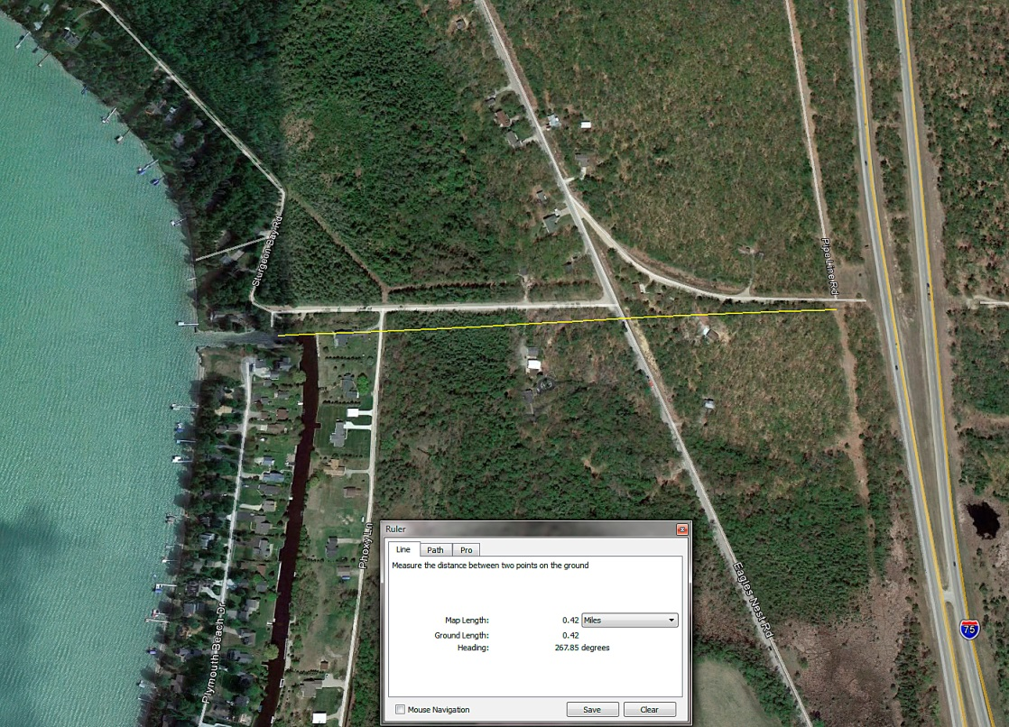
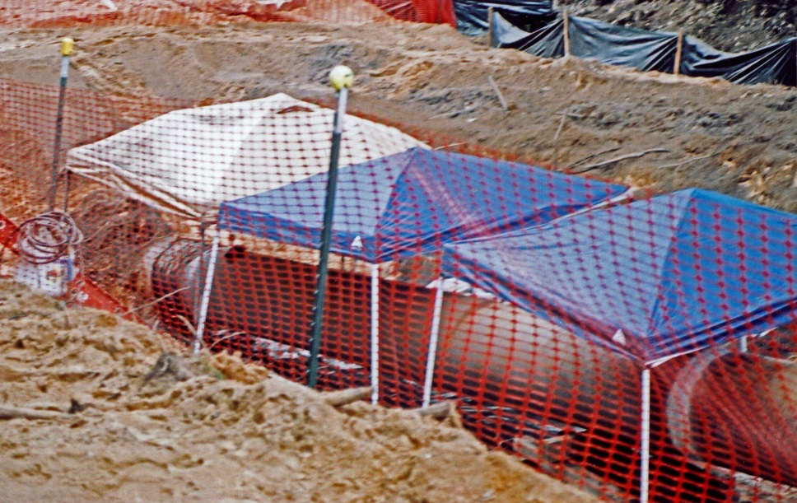
Eagles Nest Road Dig, North Indian River Exit, I-75

Slide 9
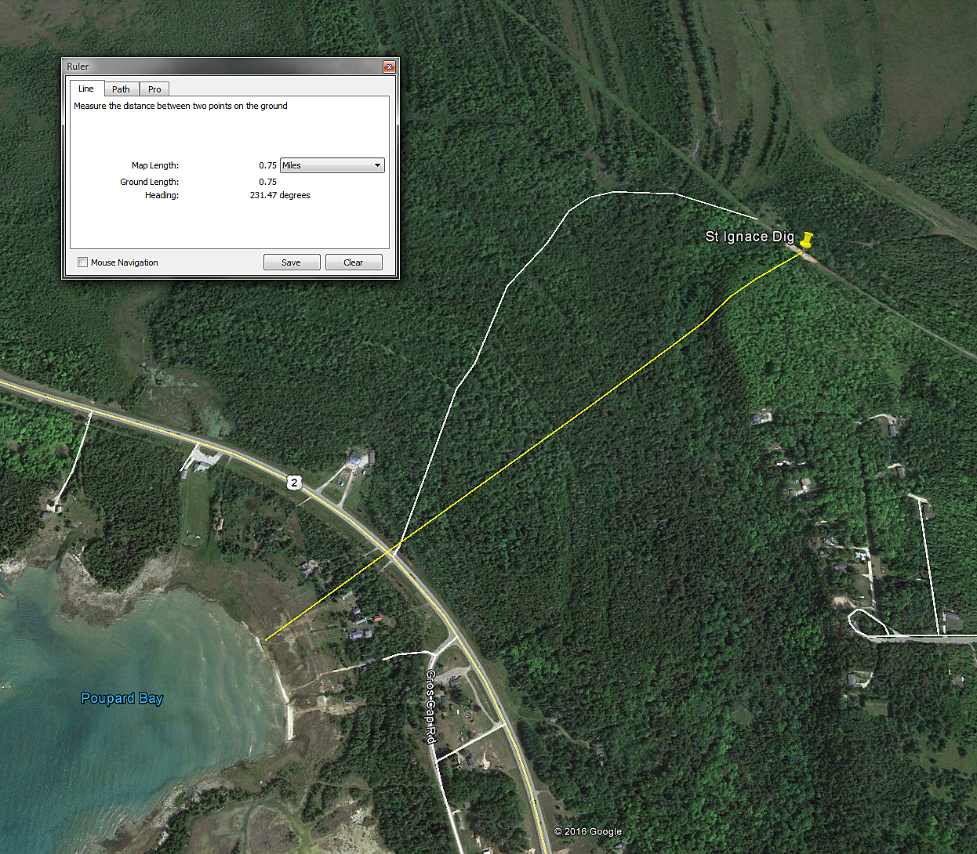
Cheeseman Road Dig, 5 Miles West of St Ignace
Kitchens Creek

Slide 10
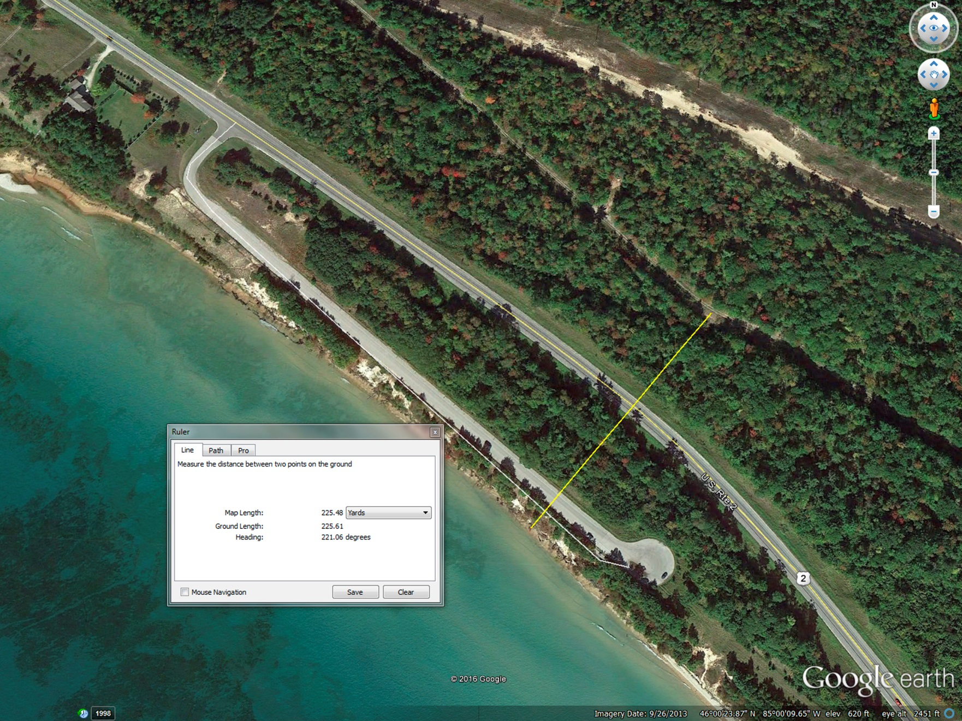
Line 5 Lake Michigan Approach, 2 mi East of Brevort
“But Mr. Olson says he has no concerns about the portion of Line 5
from Rapid River to St. Ignace, adding that Line 5 runs north of US- 2
at a greater distance from the lake than Dr. Timm specified, although
he did not say how far away Line 5 is from the lake. Mr. Olson said
that a spill would have to flow over land and over the highway to reach
Lake Michigan.” St Ignace News, Paul Gingras Reporter

Slide 11
Factors Determining the Service Life of a Vintage Pipeline
Maintaining “Fitness for Service”
Quality of materials and original design/construction
Cathodic protection system (Federally mandated)
Integrity of the corrosion preventative coating as it ages
Ability of the In Line Inspection (ILI) tools to find all developing defects
Ability of the pipeline operator to correctly analyze the ILI data
Willingness of the pipeline operator to conduct ILI verification digs and repair or replace unsafe pipe
Willingness of the pipeline operator to abandon an unfit pipeline

Slide 12
All Vintage Pipelines are Significantly Corroded and Cracked
Can In Line Inspection guarantee a pipeline is “Fit for Service”
A negative opinion cannot be proven
In Line Inspection always finds numerous flaws or “features’
All detected flaws are analyzed to determine severity and growth rate
Subsequent inspections follow these flaws and update growth projections
Numerous regulations and codes govern this “Integrity Management” process
How these regulations are applied is up to the pipeline operator
Recent very damaging pipeline ruptures call this process into question
Are existing codes and regulations adequate to insure the safety of pipelines operating beyond their design life?

Slide 13
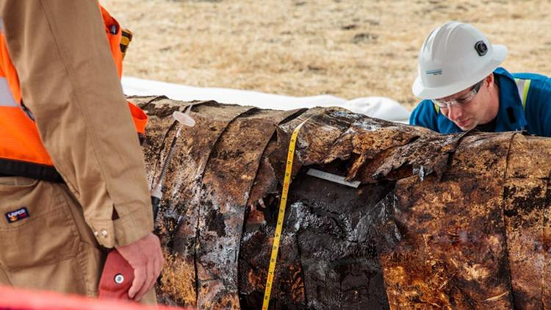
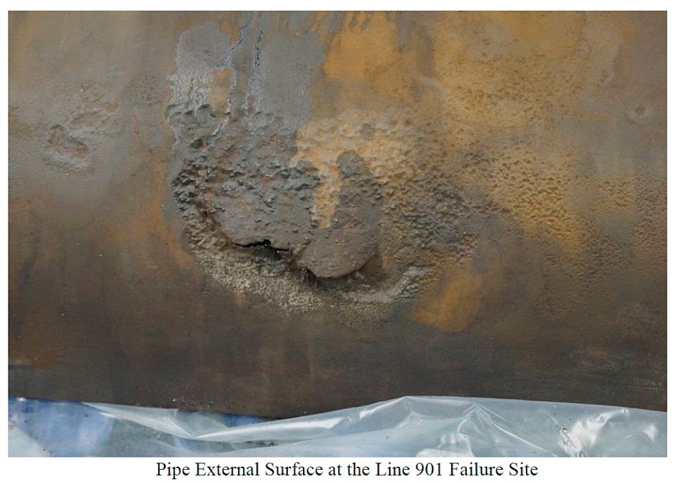
Plains All American Line 901 Rupture
Constructed in the Late 1980’s
Rupture May 19, 2015
Service Life to Major Rupture: 28 Years
142,800 Gallons Spilled
35 Minute Response Time
PHMSA Finding
The May 6, 2015 ILI survey
data indicated corrosion at
the failure site with an area
of 5.38 inches by 5.45 inches,
and a maximum depth of 47%.
The DNV-GL metallurgical analysis
physically measured corrosion at
the failure site to have a maximum
depth of 86%

Slide 14
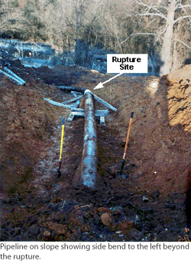
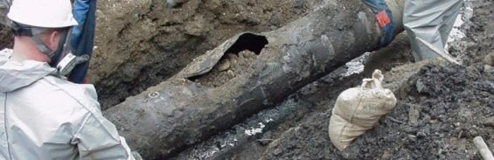
Colonial Pipeline Rupture
Constructed in 1963
Rupture June 26 1996
Service Life to Major Rupture: 33 Years
957,600 Gallons Spilled
Operator Error and Corrosion
PHMSA Finding
“A 36-INCH-DIAMETER COLONIAL PIPELINE
COMPANY PIPELINE RUPTURED WHERE A
CORRODED SECTION OF THE PIPELINE
CROSSED THE REEDY RIVER.
THE NTSB RECOMMENDS THAT THE
COLONIAL PIPELINE COMPANY REVIEW
THEIR DRUG & ALCOHOL TESTING PROGRAM”

Slide 15
12 Conclusions from PHMSA Incident Reports
All steel pipelines corrode with time
In Line Inspection (smart pig) technology doesn’t always work as advertised
In Line Inspection data can be misinterpreted
Pipeline company engineering departments can fail to recognize critical flaws
Pipeline repair/replace decisions are sometimes made without urgency
Automated leak detection and shutoff systems don’t always work as planned
Leaks and ruptures are usually found by travelers or property owners
Remote pipeline control rooms sometimes lack operating discipline
Pipeline control operators educational and training requirements vary
Oil spill cleanup efforts rarely recover more than about 30% of the spilled oil
Some crude types are very hard to recover (DILBIT)
Gambling without knowing the odds is dumb!

Slide 16
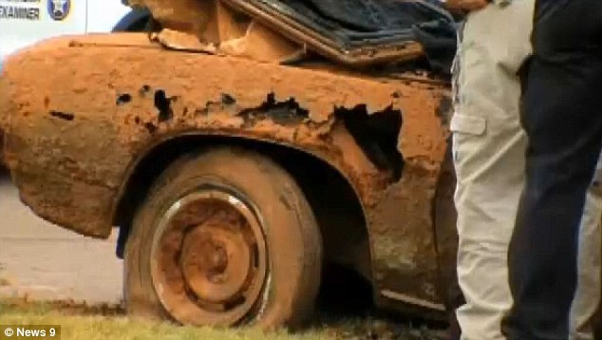
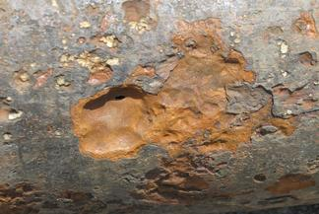
Pitting Corrosion is What Usually Makes Steel Structures Unfit for Service

Slide 17
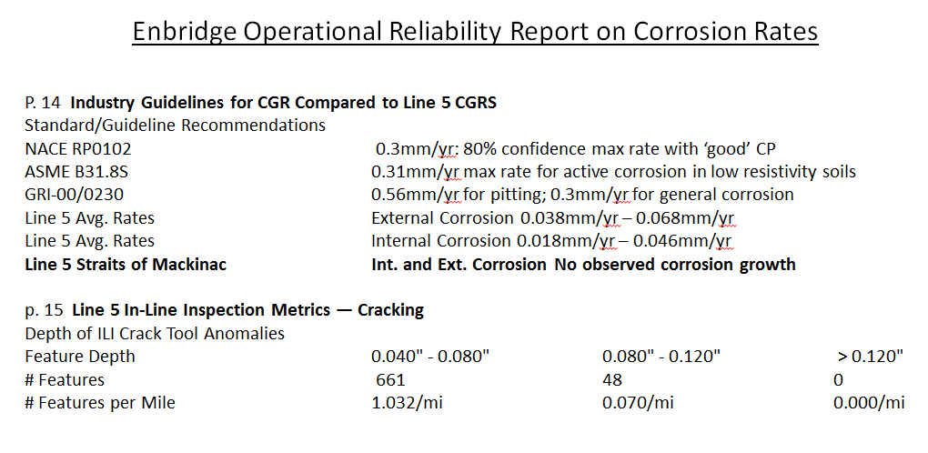
The ONLY Known Data About Corrosion of Enbridge Line 5

Slide 19
Statement by Blake Olson in Cheboygan Tribune Guest Editorial 3/5/16
“But the real issue I want to address for Cheboygan Daily Tribune readers is Timm’s
statement that Line 5 has “many holes.” That is completely false. We are mandated
by federal law to follow strict guidelines for the operation of our pipelines.
Simply put, we wouldn’t be in business operating pipelines with holes in them.”

Slide 20
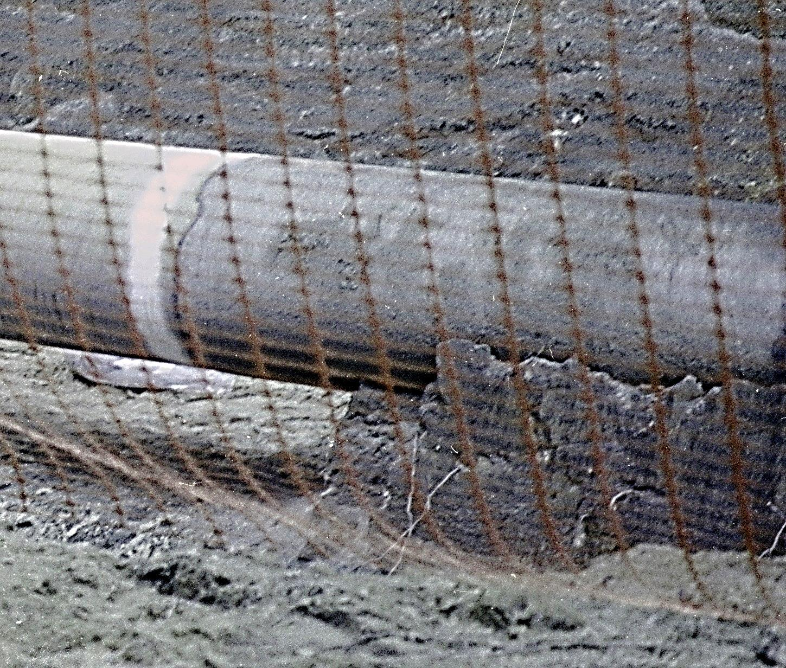
Line 5 Exposed for Unknown Repairs Ca. 2012
North Side of Learning Road East of Eagles Nest Road
Probable Location of Abandoned Eagles Nest Pumping Station
30” OD by 11/32 Wall X-52 Steel Pipe
Pipe at South End of Trench
Blasted Clean Exposing Pipe
Classic Pitting Corrosion
Worst on Bottom Half
Dark Clumped Soil under Pipe
in a Sandy Area

Slide 21
Economic Importance of Enbridge Energy Partners Line 5 to Michigan
Line 5 supplies about 85% of the UP’s propane
Enbridge has a monopoly position in propane for the UP
Northern lower supply is by truck, rail and barge @ $1.80/gal retail
UP supply is pipeline direct @ $1.??/gal retail
Spot propane at Mt. Belvieu, LA is $.35/gal
Without Enbridge and its monopoly, local wholesalers would thrive
Line 5 is the route to market for Michigan’s crude oil production
About 16,000 bbl/d or MI crude is shipped by Line 5
Alternate is 22 rail cars per day as is common practice
Line 5 supplies light crude to Michigan and Ohio refineries
Nobody builds a refinery with a single source of feedstock
Alternate studies show about 85% of Line 5 oil is exported to CA
Enbridge supplies CA subsidized, dirty oil at a slightly lower price
Enbridge contributes about $20 million annually to Michigan’s economy through jobs and taxes...and grosses about $700 million annually from line 5
Very small change compared to economic and environmental destruction

Slide 22
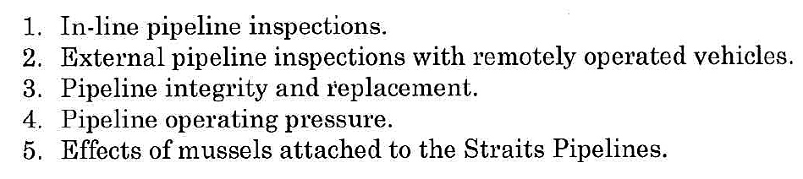
Current Status of the Governors Pipeline Board(s)
After two years of effort the Governor’s Pipeline Task Force failed to reach any
conclusions primarily because of lack of cooperation by Enbridge. Enbridge claimed
much of the requested data was either “business confidential” or “critical energy
infrastructure confidential.”
Two new Boards were set up by the Governor to study risk and alternatives
On March 11th Ag Schuette sent Enbridge a “Drop Dead” letter demanding
data on the following subjects within 30 days:
It is rumored that Enbridge did turn over a hard drive to the AG in response
The risk assessment board is only looking at the Straits crossings even though
the Governor empowered them to look at all pipelines in MI. Several board
members have tried to change this but the Chair shut them all down on cost
and timeline considerations.

Slide 23
Letter from Dr. Ed Timm to Governor Snyder and A.G. Schuette dated 2/12/16
“Please let common sense and your duties as Governor prevail and order your Pipeline Safety Advisory Board to take a holistic and fully transparent look at Line 5 everywhere it touches our State of Michigan”

Slide 24
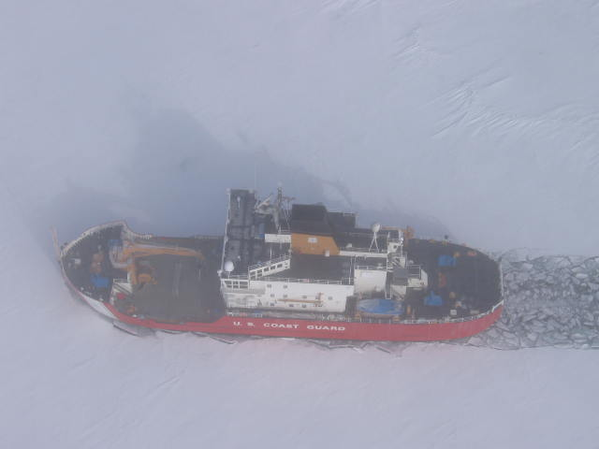
Thank You for Your Time and Patience!

